Slide 1


ML Project: Information monitoring website of the financial market using AI
Omar Louriki
A20

Slide 2
Summary
I – Introduction
I.1 - Context
I.2 - Presentation of AI Shining
II - Technical environment
II.1- Technologies used
II.2 - Methodology of work
III - Development phase
III.1- How the application works ?
III.2 - Front end development
III.2 - Dataset construction
III.4 - Back end development
IV - Demonstration
V - What comes next ?

Slide 3
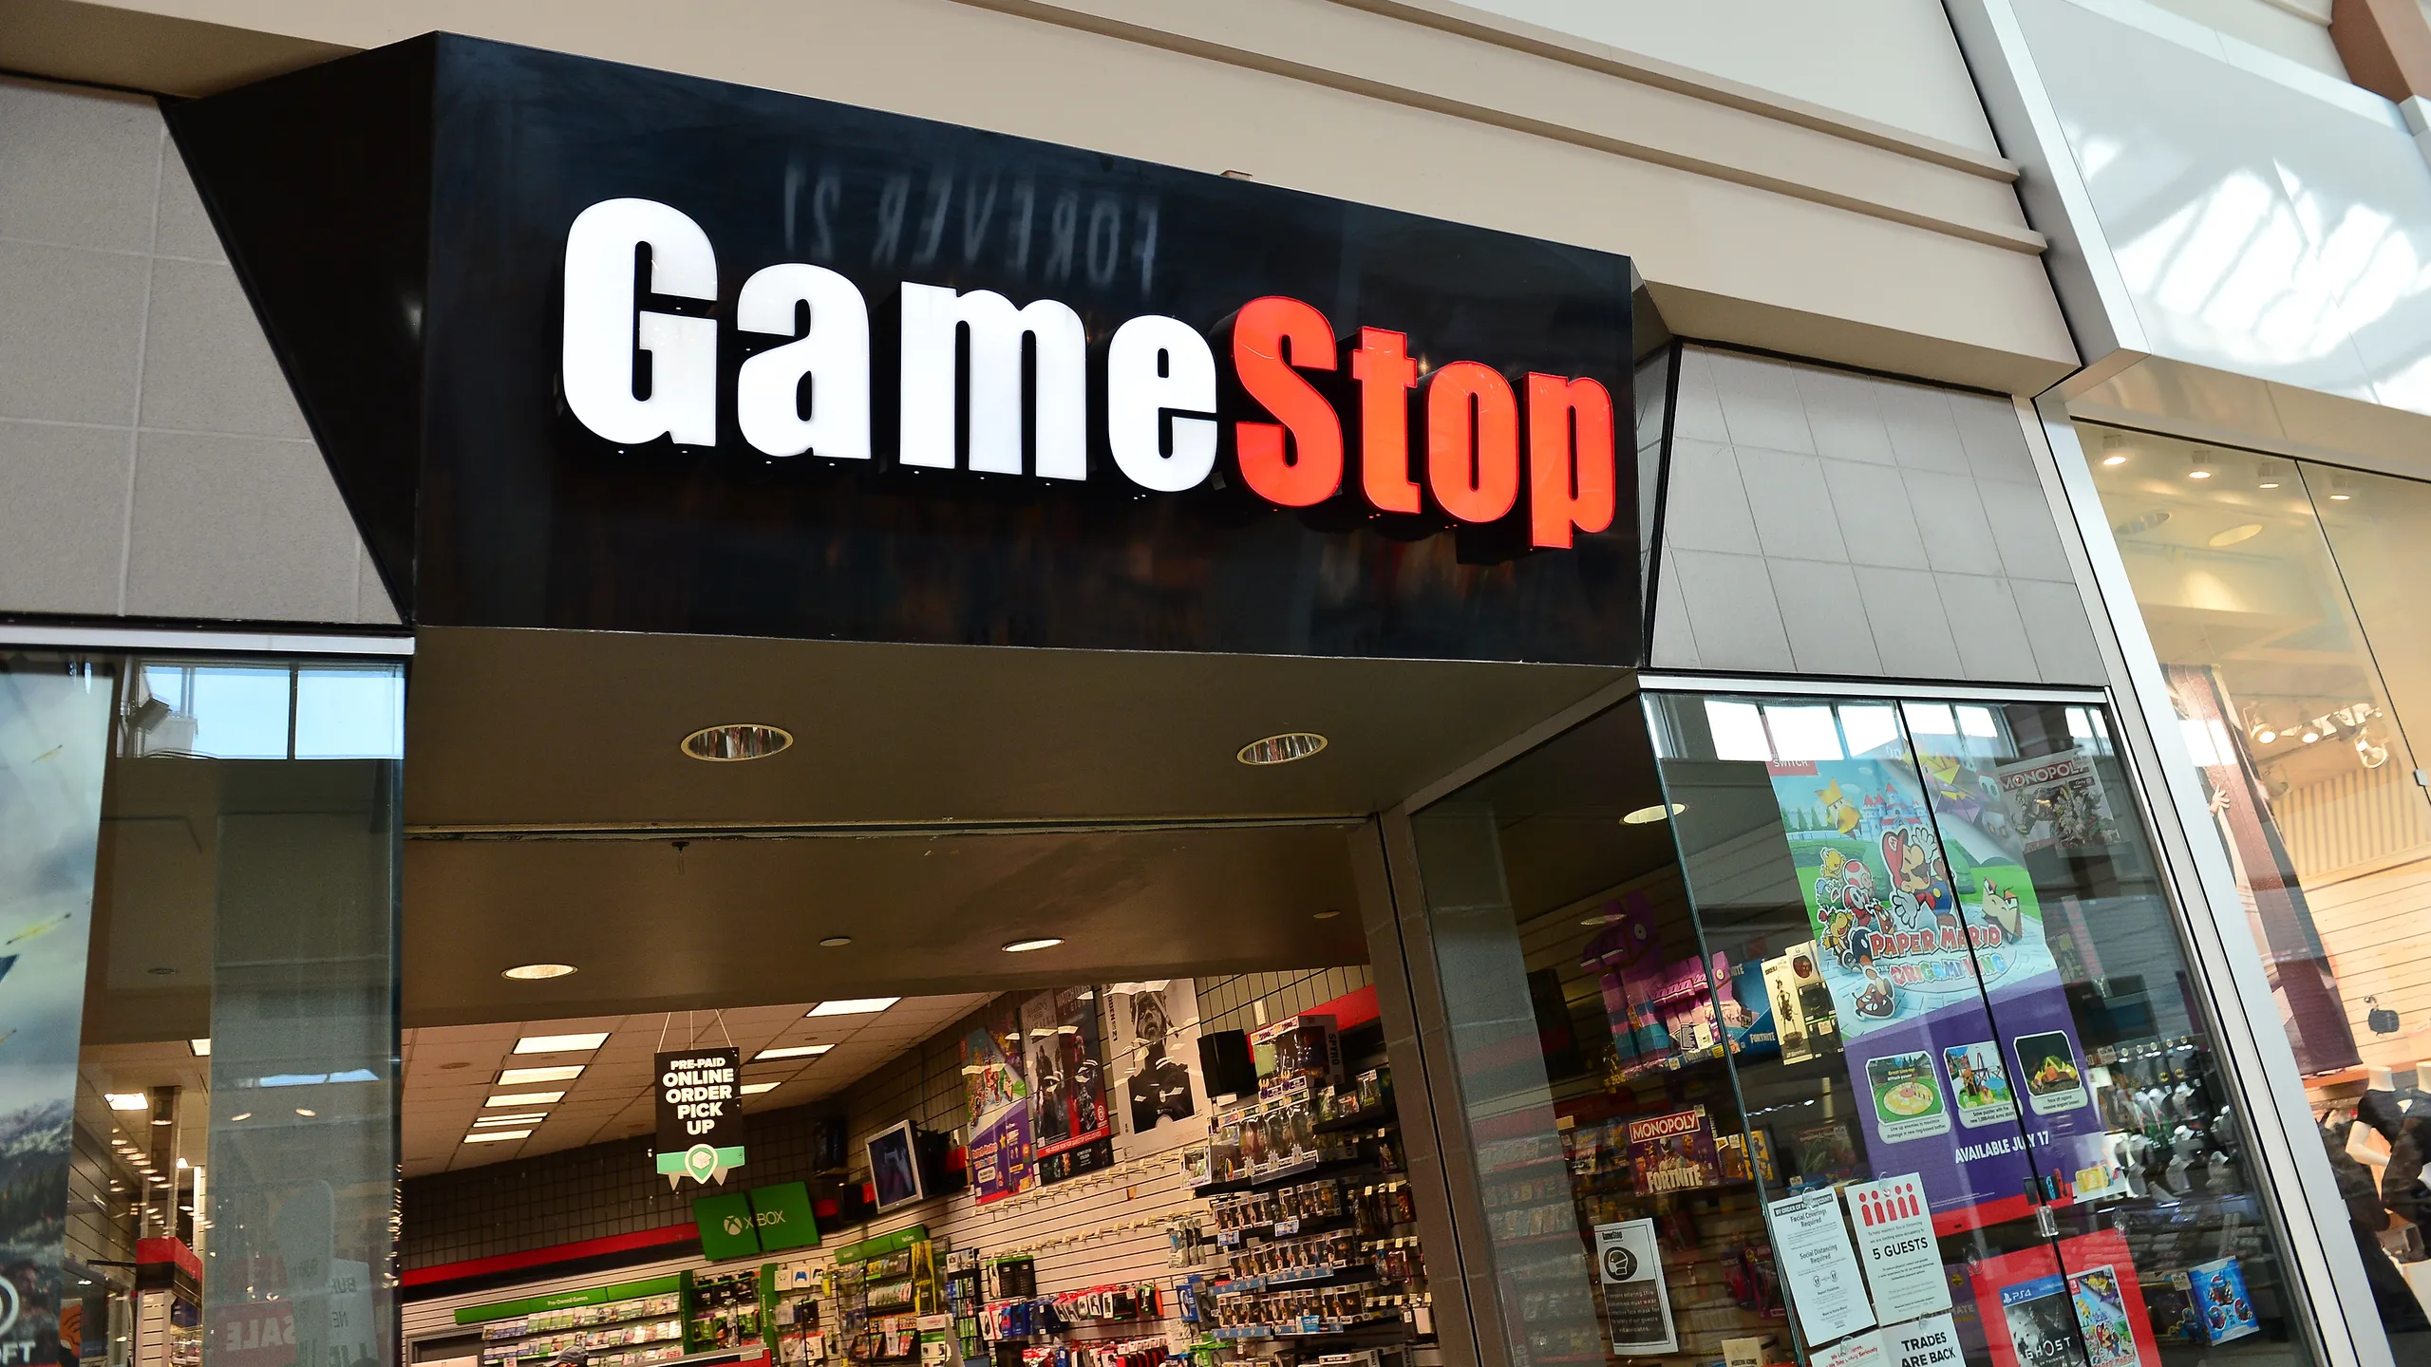
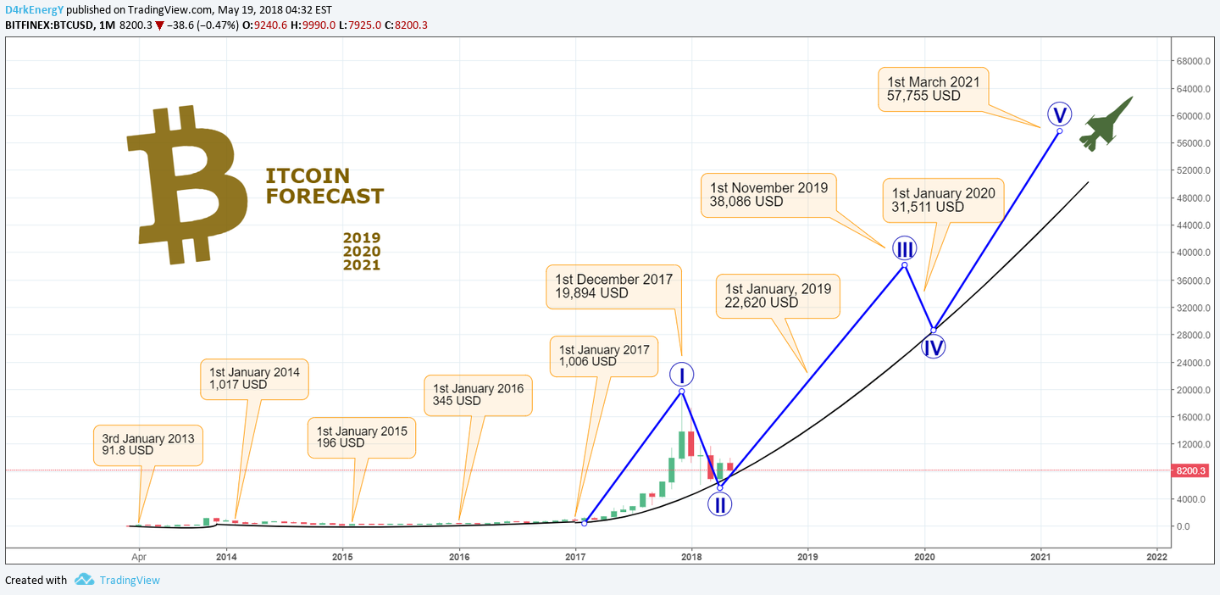
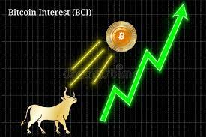
I – Introduction
I.1 – Context

Slide 4
I – Introduction
I.1 – Presentation of AI Shining
Targets: Peaple who want to invest in stocks/cryptocurrencies
Objective: Give support and informations using AI about the stock market’s current situation to help visitors making the good decisions.
Exemple of functionalities:
Web scraping / Crawler
Dashboard
…

Slide 5




II - Technical environment
II.1- Technologies used

Slide 6
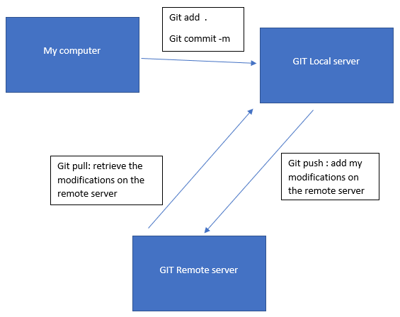
II - Technical environment
II.2 - Methodology of work
Git routine

Slide 7
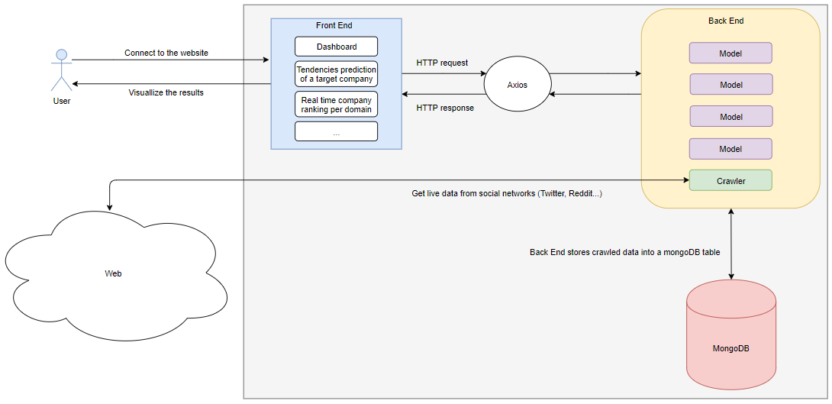
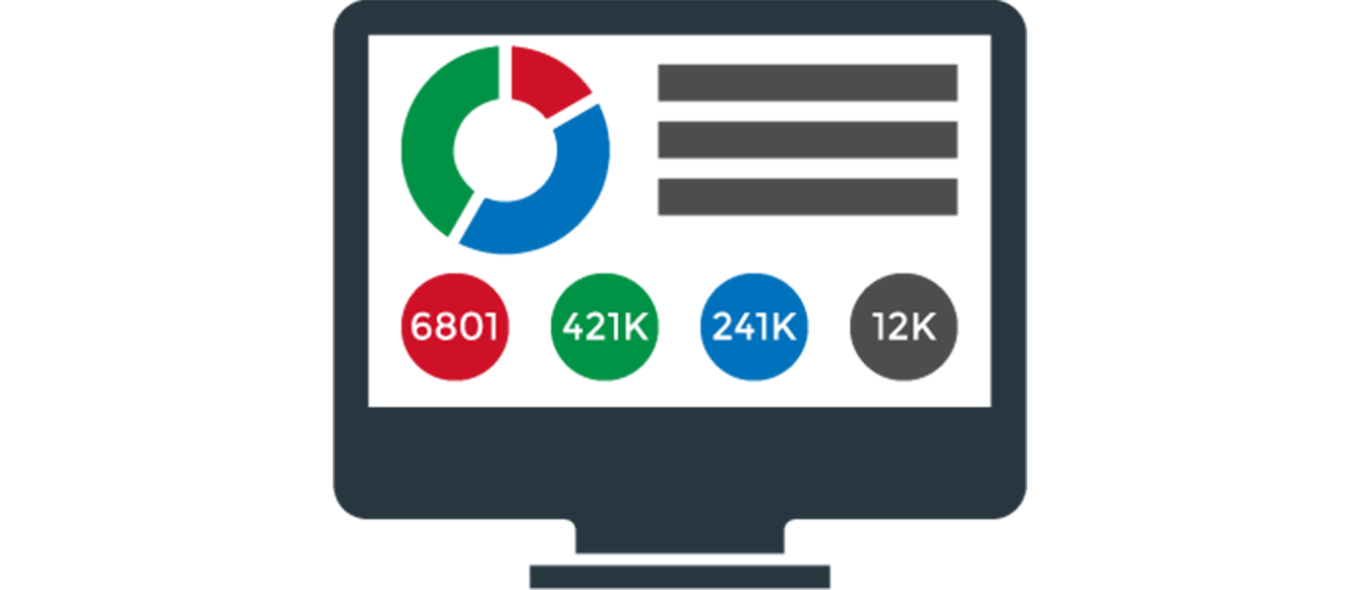
III - Development phase
III.1- How the application works ?
Application workflow

Slide 8
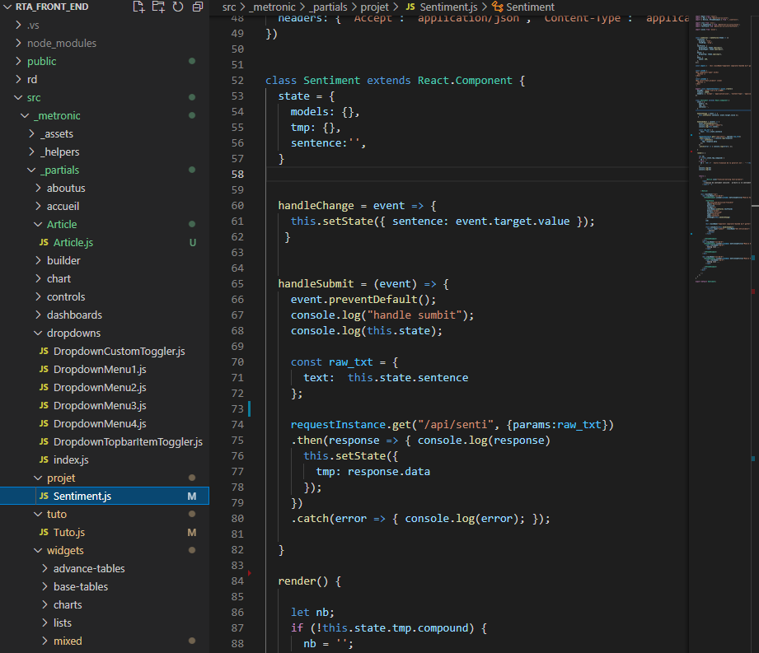
III - Development phase
III.2 - Front end development
Based on the Metronic template
Needed to learn how to use React JS and Axios (Adding and editing new pages, configurate Axios, trigger events on click…)
Fully written in JavaScript and HTML
Nivo used to build the charts

Slide 9
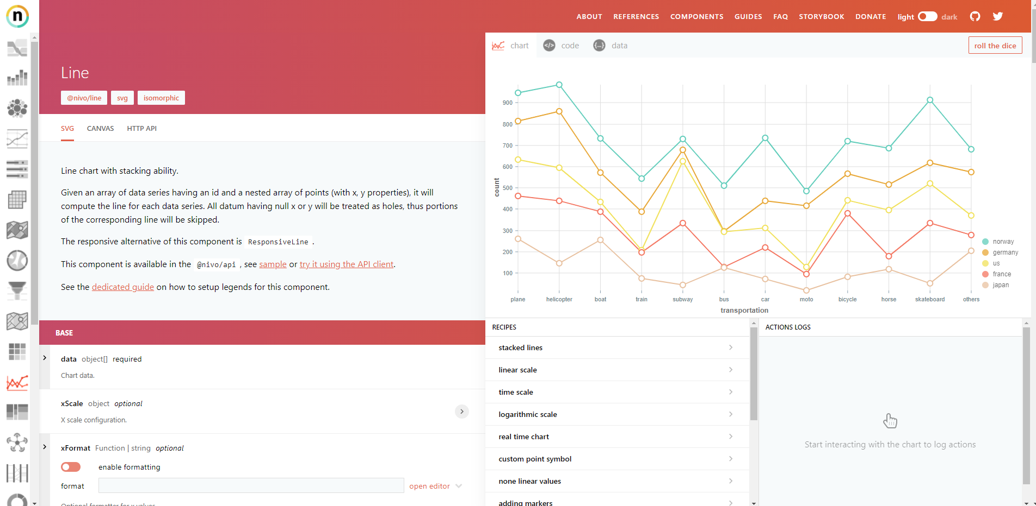
III - Development phase
III.2 - Front end development
Nivo documentation website

Slide 10
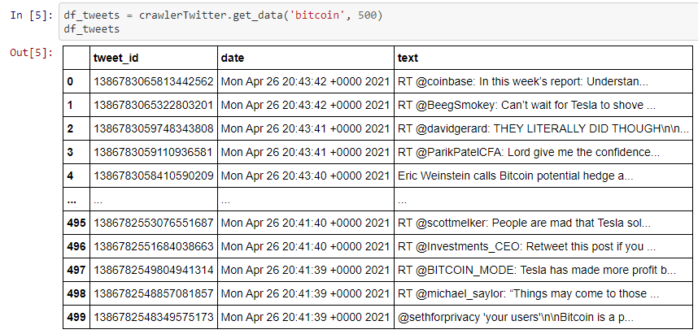
III - Development phase
III.2 - Dataset construction
Crawler to get data from Twitter and Reddit.
Tweepy to build the crawler.
Class Twitter_crawler with 3 functionalities:
Take into parameter the user name and return his n last tweets.
Take into parameter a subject name and returns all last n tweets about it.
Take into parameter a subject and returns streaming of live data.

Slide 11
III - Development phase
III.4 - Back end development
Fully developed in Python
Django
MongoDB
Only one functionality fully implemented: Sentiment Analysis
3 models:
VADER ( Valence Aware Dictionary for Sentiment Reasoning)
TextBlob
DistilBERT

Slide 12

III - Development phase
III.4 - Back end development
VADER(Valence Aware Dictionary for Sentiment Reasoning):
Static
available in the NLTK package
Sensitive to both polarity (positive/negative) and intensity (strength) of emotion
Uses Dictionary that maps words with sentiment scores.
Return the sentiment of a sentence by summing the sentiment scores of each word:

Slide 13
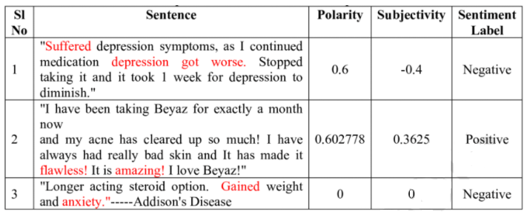
III - Development phase
III.4 - Back end development
TextBlob:
Static
available in the NLTK package
returns polarity (value between -1 and 1) and subjectivity(amount of personal opinion) of a sentence
Source: https://www.researchgate.net/publication/340028105_Enhancing_Optimized_Personalized_Therapy_in_Clinical_Decision_Support_System_using_Natural_Language_Processing

Slide 14
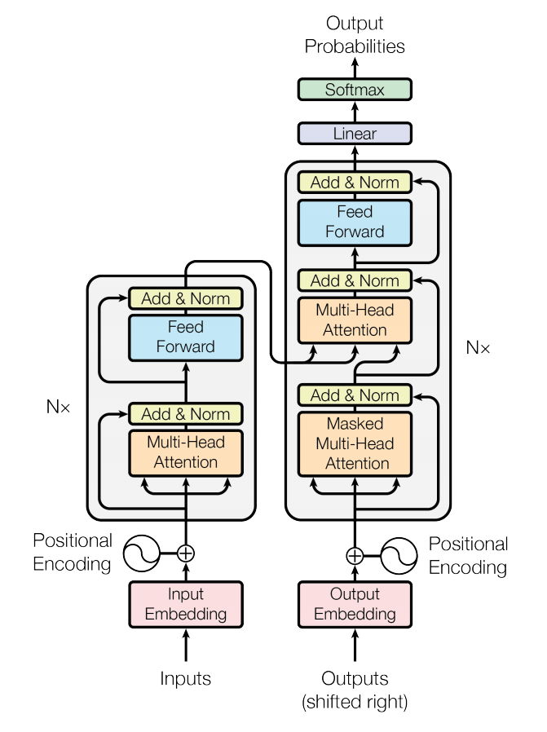
III - Development phase
III.4 - Back end development
DistilBert
Not static
Based on Transformers architecture
unsupervised learning
Pretrained model available via transformer library
Return a list of dictionaries with 2 keys, “label” and “score”
Source: « Attention is all you need » by Ashish Vaswani, Noam Shazeer and Niki Parmar

Slide 15
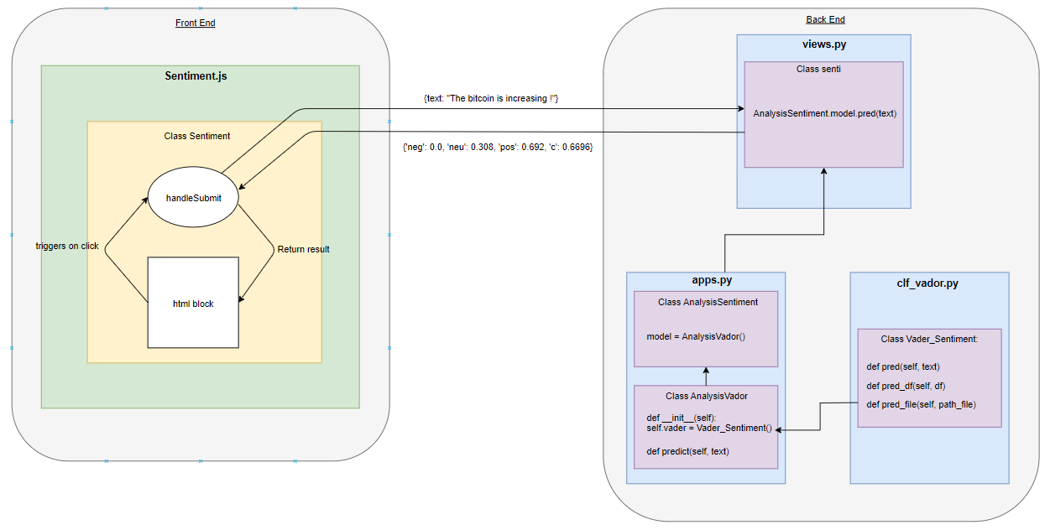
III - Development phase
III.4 - Back end development
Detailed communication between back end and front end

Slide 16
IV - Demonstration

Slide 17
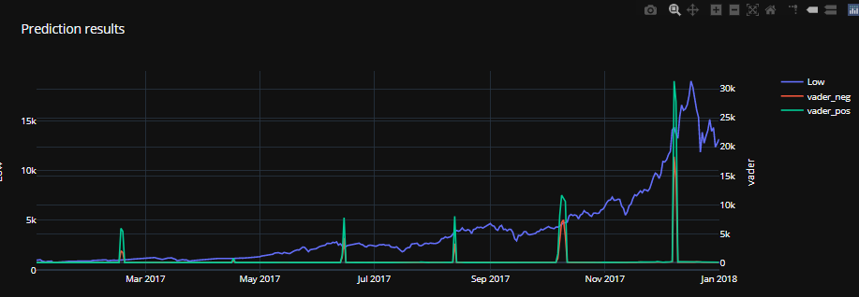
V - What comes next ?
Update the dashboards with data stored in the MongoDB database
Use sentiment score as input for new models to predict bitcoin value based on number of positive tweets
Link the Crawler with the MongoDB Database
Find more data sources
Implement other functionalities
Deploy the solution in AWS with Docker and Kubernetes

Slide 18
Thank you for your attention !

